Slide 1
HEALTH SYSTEM AND GOVERNANCE
Health Leadership and Governance Training
MOHCC,CDC,UZCHS-DCM

Slide 2
OBJECTIVES
Outline the importance of health system strengthening/the six building blocks
Define governance /health governance
Outline the context of governance
Describe problems related to health governance at all levels
Outline the responsibilities for governance at all levels of health care
Describe the application principles of governance and its application at all levels

Slide 5
HEALTH SYSTEM STRENGTHENING
The various studies and surveys carried out in Zimbabwe over the last three years point towards inadequacies in the six health system building blocks:
These are prerequisites for a functional health delivery system

Slide 6
SIX BUILDING BLOCKS
Human resources;
Medical products,
vaccines and technology;
health financing; health
information; service delivery
leadership and governance)

Slide 7
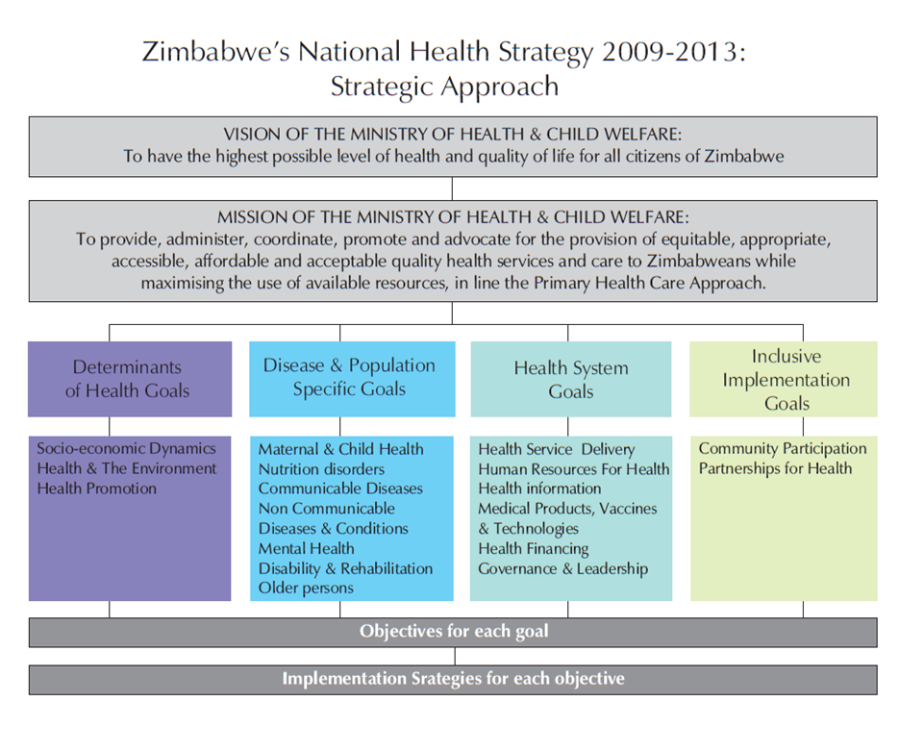

Slide 8
HEALTH CARE SYSTEM BUILDING BLOCKS
1. Adequate, skilled and Human Resources for Health.
2. Supply of medicines and medical supplies:-
3. Provision of functional Equipment
4. Provision of Transport:-
5. Ensuring a sustainable and predictable Financial Base:-.
6. Need to address the issues of leadership and governance at all levels

Slide 9
A GOVERNMENT
A group of people that governs a community or unit. It sets and administers public policy and exercises executive, political and sovereign power through customs, institutions, and laws within a state. A government can be classified into many types--democracy, republic, monarchy, aristocracy, and even dictatorship.
http://www.businessdictionary.com/definition/government.html

Slide 10
WHAT IS GOVERNMENT
Government normally consists of legislature, executive, and judiciary. Government is a means by which organizational policies are enforced, as well as a mechanism for determining policy. Each government has a kind of constitution, a statement of its governing principles and philosophy. Typically the philosophy chosen is some balance between the principle of individual freedom and the idea of absolute state authority (tyranny)

Slide 11
Governance
There are three dimensions: authority, decision-making and accountability.
Governance has been defined to refer to structures and processes that are designed to ensure accountability, transparency, responsiveness, rule of law, stability, equity and inclusiveness, empowerment, and broad-based participation.
Institute of Governance 2015

Slide 12

Governance

Slide 13
IS GOVERNANCE VISIBLE
Since a process is hard to observe, the measurement of governance tend to focus on the system or framework upon which the process rests - that is, the agreements, procedures, conventions or policies that define who gets power, how decisions are taken and how accountability is rendered

Slide 14
Health Governance
Governance in the health sector refers to a wide range of steering and rule-making related functions carried out by governments/decisions makers as they seek to achieve national health policy objectives that are conducive to universal health coverage. www.who.int/healthsystems/topics/stewardship/en/

Slide 15
WHY HEALTH GOVERNANCE
There has been a realization that resources allocated to health will not achieve their intended results without attention to governance.
This relates to global overrunning of countries with donor resources resulting in duplication
Poor health system governance at country level threatens to undermine the effective utilization of the funds ( corruption inefficiency)

Slide 16
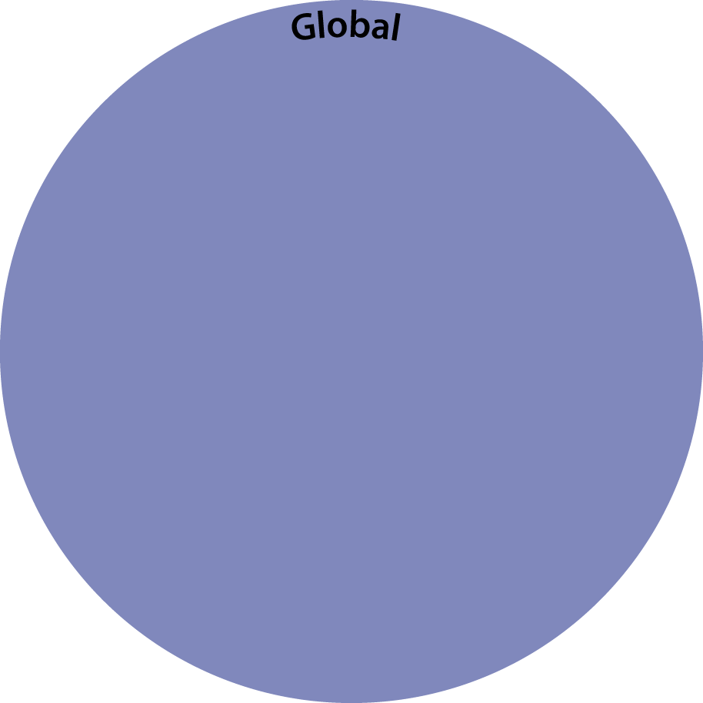
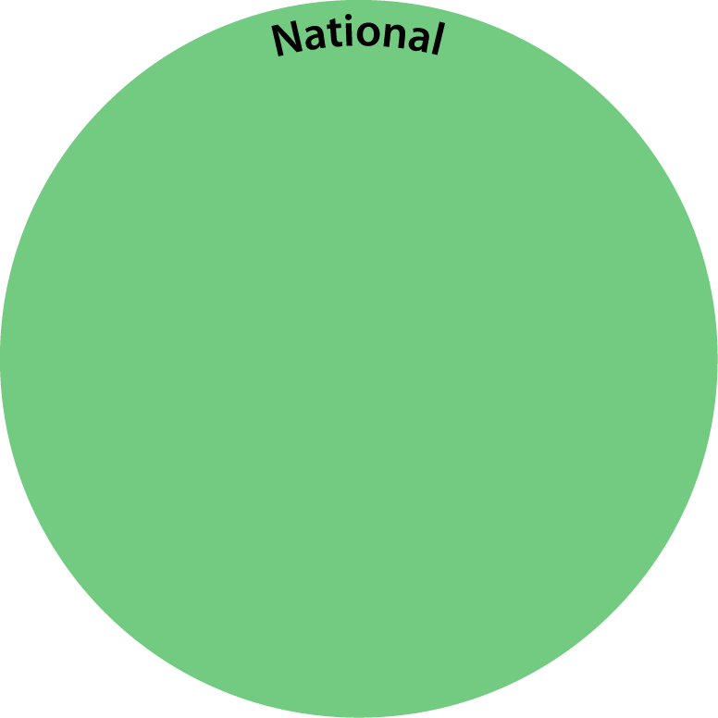
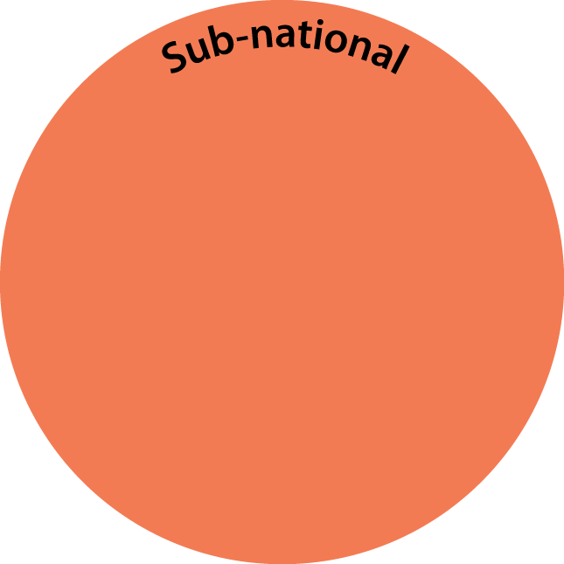


GOVERNANCE LEVELS

Slide 17
RESPONSIBLE GOVERNANCE
Competently directing health system resources, performance, and stakeholder participation toward the goal of saving lives and doing so in ways that are open, transparent, accountable, equitable, and responsive to the needs of the people.(esp. poor people)

Slide 18
FACTORS THAT MAY REDUCE GOOD GOVERNANCE
HLMGP

Slide 19
GOVERNANCE LEVELS

Slide 20
GLOBAL FACTORS
There has been unprecedented growth in funding for global health,
Global health is being viewed as a foreign policy issue of first-order importance.
Global health has become an essential part in the equation of international relations and global security.
Political differences

Slide 21
GLOBAL FACTORS
The outbreak of pandemic influenza A (H1N1) found countries scrambling for access to vaccines, an unseemly process that led the World Health Organization to call for a new "global framework" on equitable influenza vaccine access showed the inadequacy of global health governance.
Efforts to address these and other global health problems often acknowledge that existing institutions, rules, and processes of global governance are insufficient to support collective action.

Slide 22
GLOBAL ENTRANCE TO COUNTRIES
Overlapping and sometimes competing regime clusters that involve multiple players addressing different health problems through diverse processes and principles.

Slide 23
GLOBAL LEVEL
Lack of coordinated operational structures
Bias in Allocation and distribution of public health funding to countries
Inadequate recognition of national government policies and priorities
Diverting national governments from their priorities
Duplication of efforts
Verticalised selective funding
Funding based on funding country priorities

Slide 24
NATIONAL LEVEL SYSTEMS FACTORS
% Budget allocation for health from the fiscus
Inadequate dissemination of information about health performance to all sectors
Lack of accountability mechanisms for the health sector.
Inability to coordinate various partners involved in health programmes
The right to health mechanisms
Non existence of or Unclear National policy and strategic plans(Dissemination and distribution)

Slide 25
SUBNATIONAL LEVEL SYSTEM FACTORS
In adequate manpower capacity for decentralization
Inadequate skills among HW for planning, budgeting, monitoring, and directing the delivery of services
Inadequate resource allocation per programme
Lack of guidance on programming(NHS)
Uncoordinated planning (Causing Confusion at lower levels)
Inadequate resource allocation at national level
Poor conditions of service

Slide 26
OPERATIONAL LEVEL
Inadequate understanding of national health policies vision mission statement and objectives
Poor translation of health services regulations
Inadequate skills to action duties and responsibilities as assigned
Inadequate resources manpower material medicine equipment
Work load
Poor conditions of service

Slide 27
HEALTH WORKER LEVEL
Having your hands greased
Accepting things that fall off from the back of a lorry
Accepting bribes that may interfere with your decision making process
Failure to declare donated asserts/donor funds
Inadequate skills for planning, budgeting, monitoring, and directing the delivery of services
Using official time for private business
Unwarranted absenteeism
Unethical practices
Insubordination indiscipline

Slide 28
HEALTH WORKER LEVEL
Diverting patients from public institutions
Informal charging of patients
Illegal use of public facilities for private work when a patient has to pay both government and private fees
Charging a patient for services when it is part of your duties to provide such services e.g. Maternity, pharmacy services
Demanding payment for essential services that the community is already entitled to e.g. collecting a body from the mortuary

Slide 29
GLOBAL, NATIONAL, SUBNATIONAL, DISTRICT, INDIVIDUAL LEVELS
INSTITUTING GOOD GOVERNANCE

Slide 30
THE IDEAL
The principles represent an ideal that no society has yet achieved but which all those interested in good governance should pursue.

Slide 31
PRINCIPLES GOVERNANCE
Social participation, systems responsiveness
Fighting illegal practice rule of law
Participation and equity inclusiveness
Pro-poor approaches
Information and capacity assessment
Policy formulation Vision
Accountability and transparency
Effectiveness and efficiency –
State building

Slide 32
GOVERNANCE LEVELS

Slide 33
WHO
WHO plays a leading role in global governance. The first part is organized around the formal governance structures of WHO working through World Health Assembly meetings with Member States)

Slide 34
STRENTHENING GLOBAL GOVERNANCE
International Health Regulations 2005 (IHR 2005),
The Millennium Development goals
WHO providing guidelines and policies PHC
Sustainable development goals
Strengthening national health systems in developing countries;
Working with national government health priorities
Unbiased allocation of resources per country through country coordinating funding mechanisms

Slide 35
SOCIAL PARTICIPATION
A broad range of stakeholders, including representatives of all sectors and government, understand health issues and be involved in planning, budgeting, and monitoring health-sector actions.
The health system is responsive to the input of communities.
Health care users should be able to know and make choices of services offered
Establish mechanism for participation of patient networks and civil society institutions

Slide 36
BROAD PARTICIPATION AND CONSULTATION
State on its own cannot address all issues (determinants of health)
Private sector and civil society should be recognized as partners in health care delivery
Church related services tend to be more accessible to the poor
Establish mechanism for consultation and participation

Slide 37
ACCOUNTABILITY /TRANSPARENCY RULE OF LAW
Fighting illegal practice
Adhering to rule of law
Zero tolerance to corruption in the health care system
Setting up anticorruption mechanisms
Transparent procurement procedures
Use of correct tender procedures
Accounting for resources used (acquittals)
Planning together a for the common purpose

Slide 38
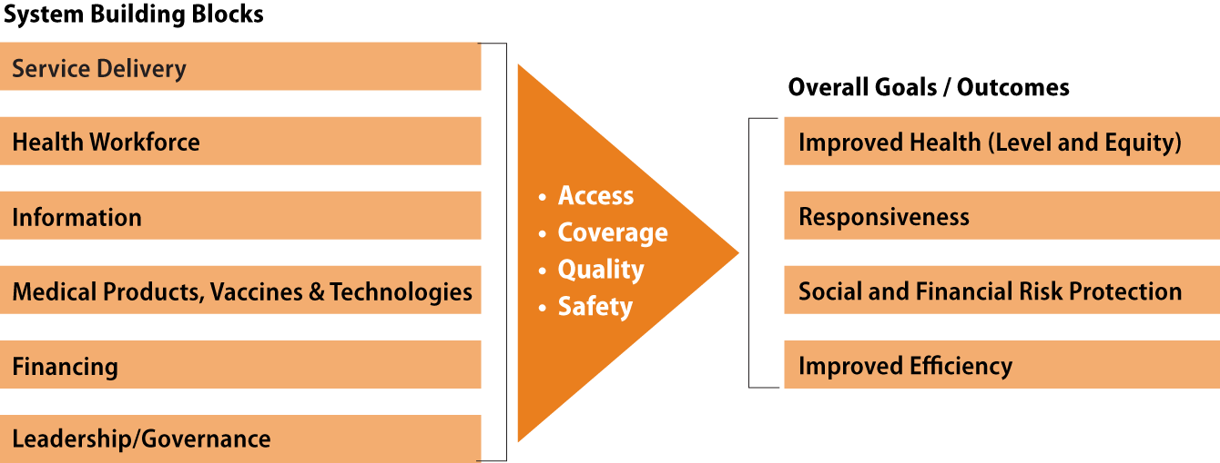
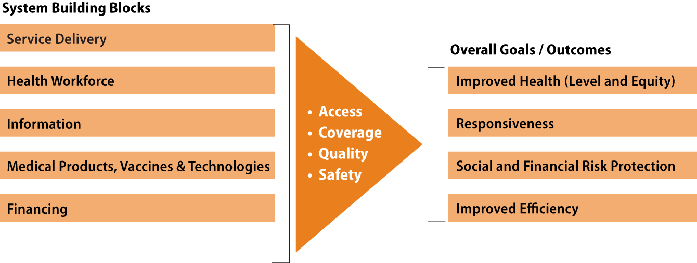

EFFECTIVENESS EFFICIENCY / HEALTH SYSTEM PERFORMANCE

Slide 39


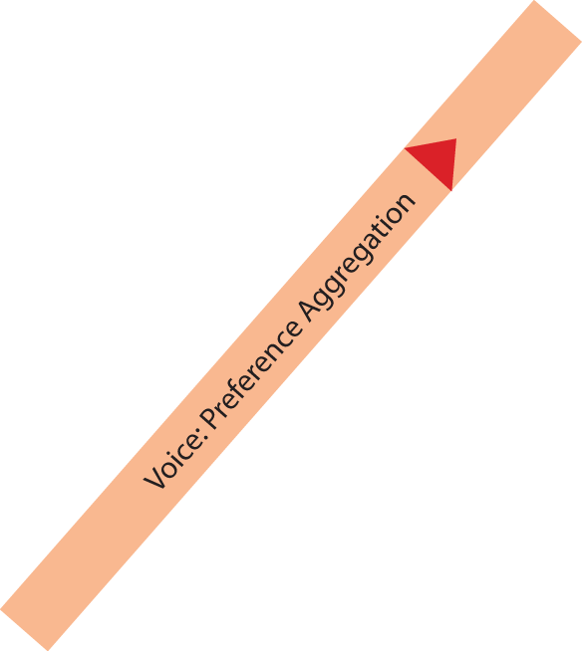
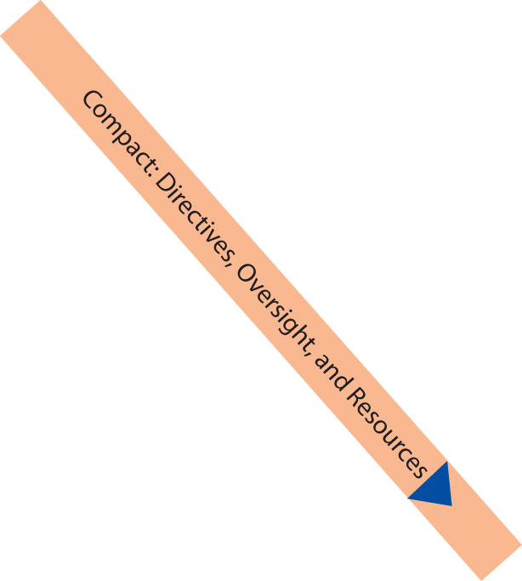


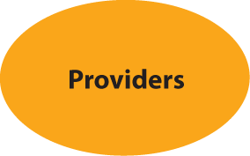
PARTICIPATION CONSENSUS RESPONSIVENESS EQUITY INCLUSIVENESS

Slide 40
INFORMATION AND ASSESSMENT CAPACITY
Information about trends in health care and health systems performance
Develop a system of information analysis linked to planning at the operational level including the community.

Slide 41
POLICY FORMULATION AND PLANNING
Appropriate processes should be in place to develop, debate, pass, and monitor legislation and regulations on health issues.
The government has a functional planning process consistency and coherence between health sector laws or plans and actual implementation.
Train personnel at district level in competencies on negotiation dialogue and participatory methods

Slide 42
PRO POOR MARGINALISED GROUP APPROACHES
Gender sensitivity
Create equal opportunities for access to care
Reduce regional disparities through transfer mechanisms
Ensure access to basic services for all through subsidizing health costs

Slide 43
BALANCING STATE PRIVATE & NGO PARTNERSHIPS
Create mechanisms and structures for partner participation NGOs, public, private sector partnerships structures

Slide 44
ELEMENTS OF STATE BUILDING
STATE
Legitimacy
Effectiveness
Civil Society/Voice
Compact/Policies
Consumers
Health Systems
Marketplace
Adapted from World Development Report, World Bank 2004.

Slide 45
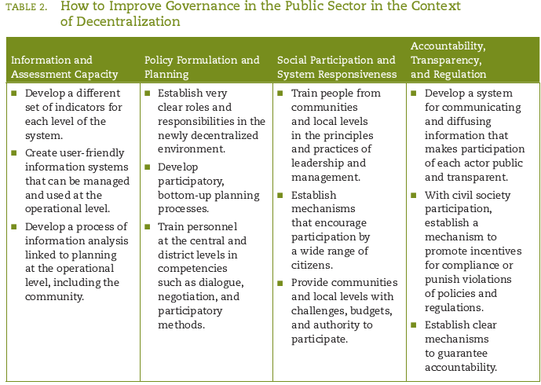

Slide 46
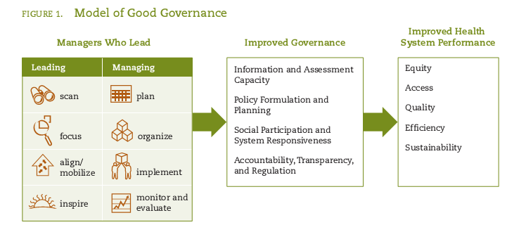

Slide 47
WHERE ARE WE
National health strategy and a lot of other documents are in place
There has been a lot of effort towards improving the building blocks
Competency based continuing education for health personnel
The health system is still largely dependant on donor funding

Slide 48
Zimbabwe Health Governance
Professionalism
Ethics
Leadership, Management, team work
Working conditions
Information systems, surveillance operation research HIS
Strengthening district health systems 6 Pillars
National Health strategy Vision policies Health service regulations
Principles of PHC
partnerships

Slide 49
HEALTH SYSTEM CONCEPTUAL FRAMEWORK
Social Determinants of Health
SYSTEM BUILDING BLOCKS
GOALS OF HEALTH SYSTEM
Information Support
Governance & leadership
Service provision
Responsiveness
Coverage
Health workforce
Quality, safety
Health
Medical products, technology
Efficiency
Provider performance
Financing
Financial protection
Equity

Slide 50
REFERENCES
The Challenges of Global Health Governance Author: David P. Fidler, James Louis Calamaras Professor of Law, Indiana University School of Law Publisher Council on Foreign Relations Press Release Date May 2010
The Future of Foreign Assistance Amid Global Economic and Financial Crisis Author: Laurie Garrett January 2009

Slide 51
REFERENCES
Health system strengthening - current trends and challenges. Executive Board 128th session, Geneva, 17-25 January 2011. (EB128/37). Available at: http://apps.who.int/gb/ebwha/pdf_files/EB128/B128_37-en.pdf
Islam, M., ed. 2007. Health Systems Assessment Approach: A How-To Manual. Submitted to the U.S. Agency for International Development in collaboration with Health Systems 20/20, Partners for Health Reformplus, Quality Assurance Project, and Rational Pharmaceutical Management Plus.
Arlington, VA: Management Sciences for Health. Available at: http://www.healthsystems2020.org/content/resource/detail/528/
The world health report 2000: health systems: improving performance. Geneva, World Health Organization, 2000. Available at: http://www.who.int/whr/2000/en/whr00_en.pdf
WHO Terminology Information System [online glossary] http://www.who.int/health-systems-performance/docs/glossary.htm

